Slide 1
IT4785/IT4785E
Mobile Programming

Slide 2
Lecture’s information
Hoàng Văn Hiệp
Faculty: Computer Engineering
Email: hiephv@soict.hust.edu.vn
Research interests
GNSS
P2P network
Projects:
IoT projects, responsibility for Android programming part.

Slide 3
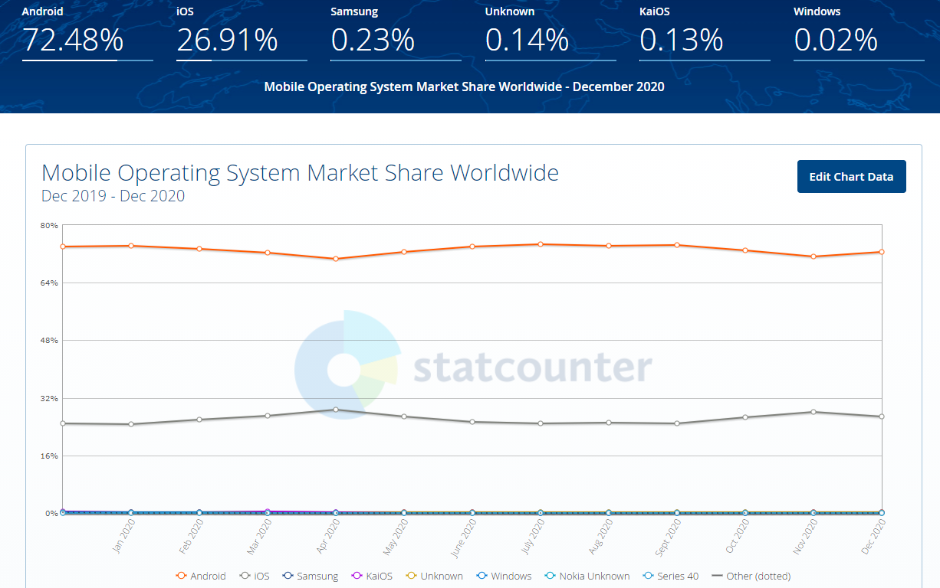
Why Android?

Slide 4
Introduction
Mobile platforms
Android
iOS
Windows: tablet versions
Tizen?
IoT devices
This subject focus on Android platform.

Slide 5
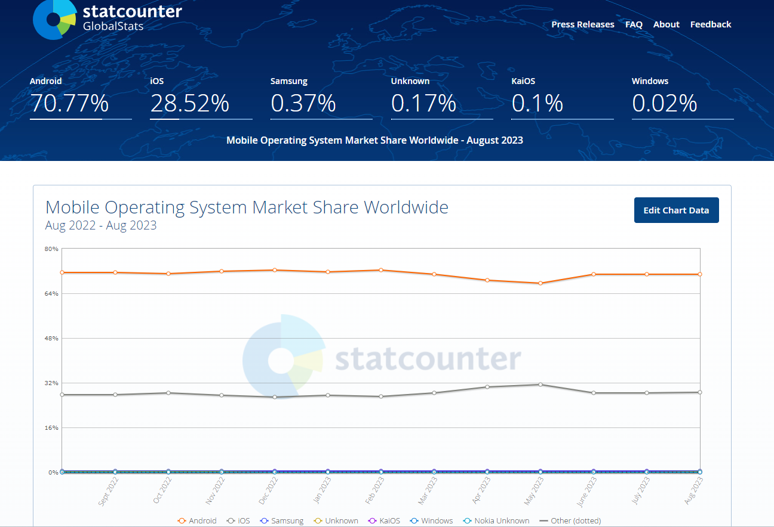
Why Android?

Slide 6
Mobile programming
Directions:
Native
Web-based
Multi-platform
React native
Xamarin
Unity
…
This subject focus on native approach.

Slide 7
Why Android
The most popular platform
Open source by Apache license
Google stands behind
Various devices
mobile
tablet
TV
IoT devices

Slide 8
Why native approach?
Learn not only language but also the platform
Go deeper to OS layer, i.e., work with hardware devices
Performance

Slide 9
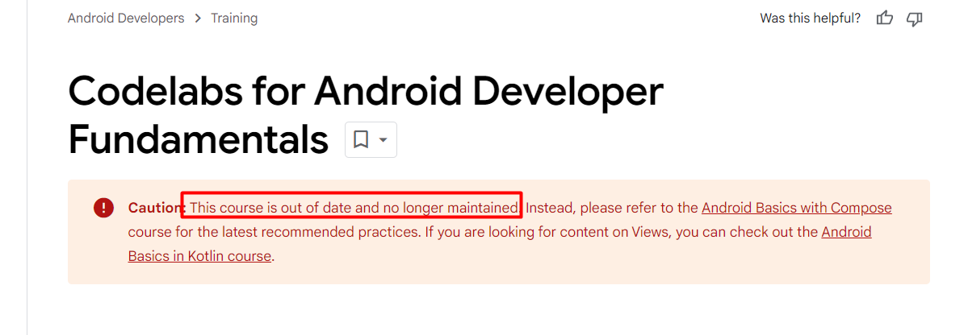
Scope
Android programming
Focus on native programming
Ngôn ngữ Java
Ngôn ngữ Kotlin

Slide 10
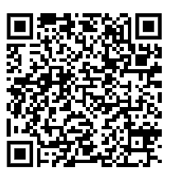
References
Android developer (google)
Code lab for android developer
Android programing tutorial

Slide 11
Some Android-based projects

Slide 12
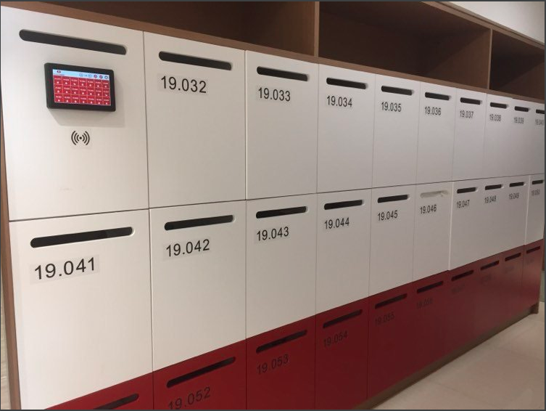
Smart Locker

Slide 13
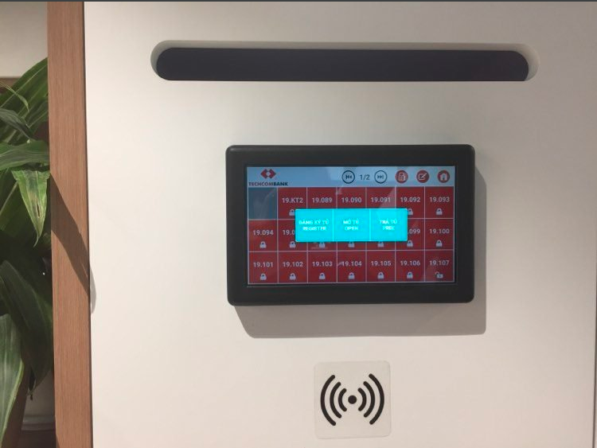
Smart Locker

Slide 14
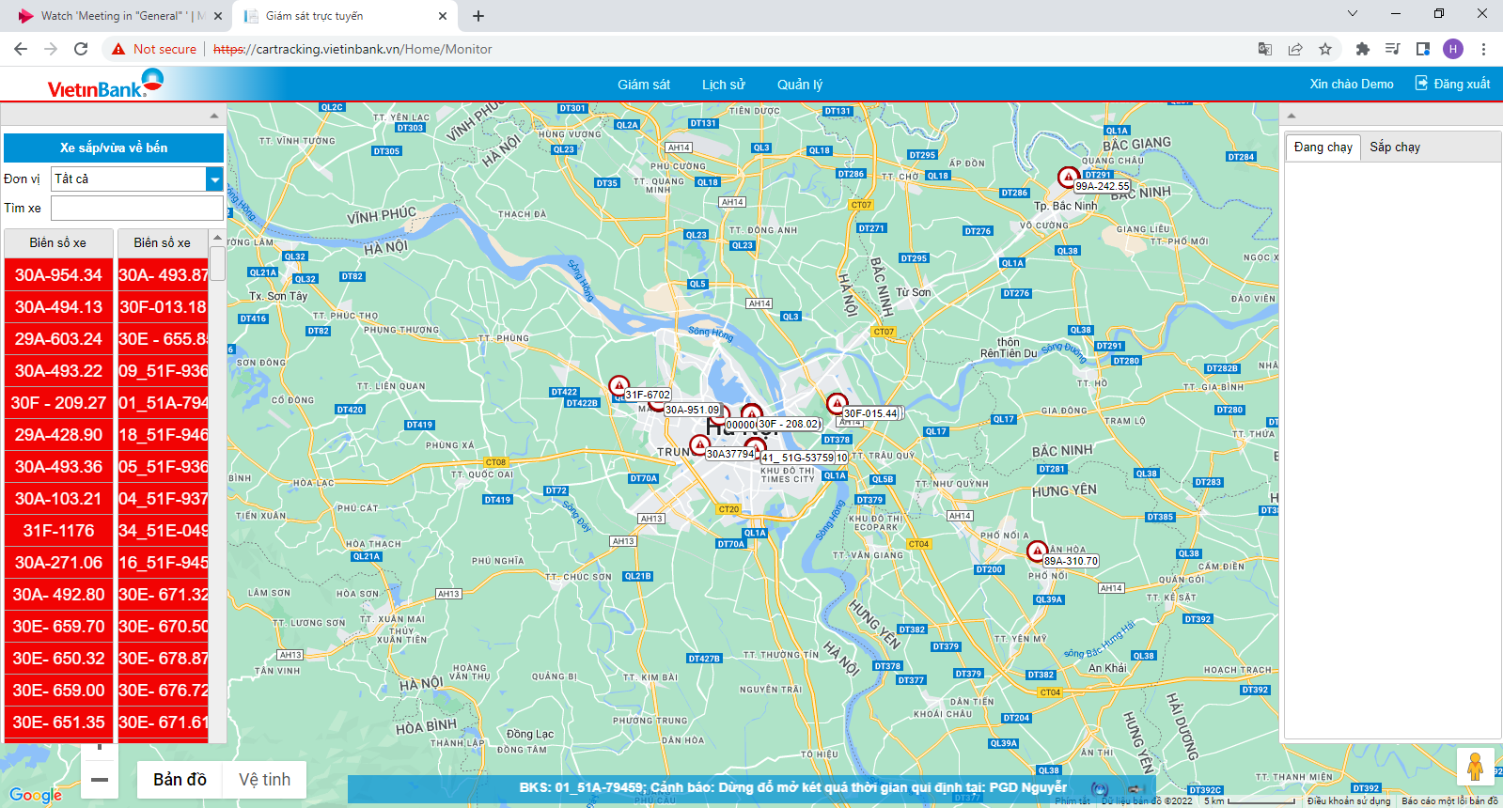
Bank’s cars tracking system

Slide 15
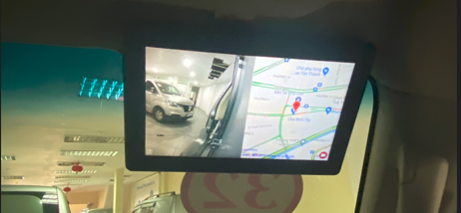
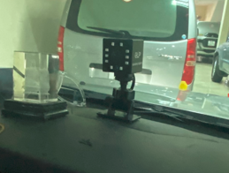
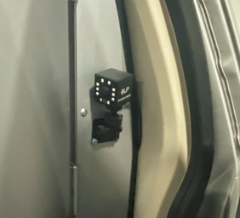
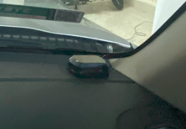
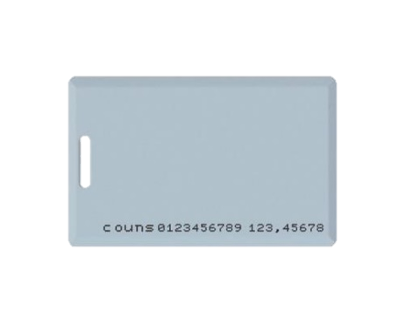
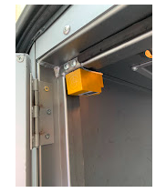
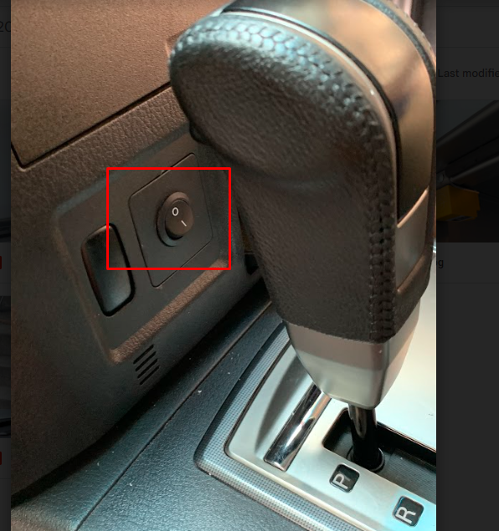
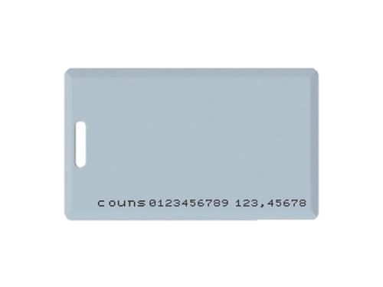

Bank’s cars tracking
1
2
Main Android device
Frontal cam
Rear cam
3
4
5
6
GPS antenna
7
RFID cards
Open strongbox
sensor
SOS button
Alarm Speaker

Slide 16
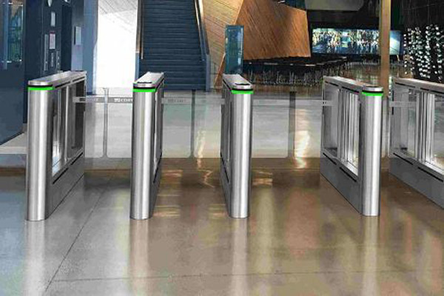
Access control

Slide 17
Evaluation
Attend the class - mini quizzes
Demo project (optional, bonus points)
Mid-term (40%)
Mid-term = (average(mini quizzes) + mid-term exam)/2
Final-term examination (60%)

Slide 18
Content
4 units with a total of 13 lessons across 13 weeks
Extra units
Unit 1(3 weeks)
Unit 2 (3 weeks)
Unit 3 (6 weeks)
Unit 4 (1 week)
Get Started with Kotlin
Basics, Functions, Classes & Objects, Extensions
Introduction to Android
First App, Layouts, Navigation
Android App Architecture
App Architecture, Data Persistence, Display Lists, Connect to Internet, Background Work
App Design
App UI Design
Working with Native C
Working with hardware peripherals

Slide 19
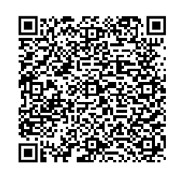
Communication
TEAM

